Slide 1


FAIR: An international social, legal and technological paradigm for data discovery and reuse by humans and machines
Michel Dumontier, Ph.D.
Distinguished Professor of Data Science
Director, Institute of Data Science

Slide 2
An increasing number of discoveries are made using other people’s data

Slide 3
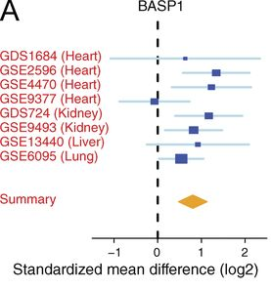
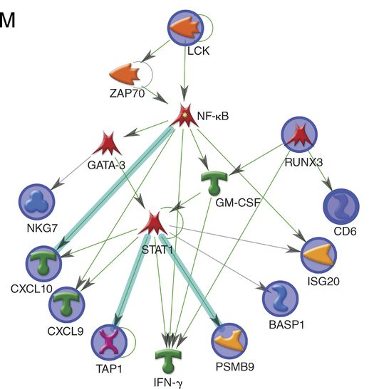
A common rejection module (CRM) for acute rejection across multiple organs identifies novel therapeutics for organ transplantation
Khatri et al. JEM. 210 (11): 2205
DOI: 10.1084/jem.20122709
Main Findings:
CRM genes correlated with the extent of graft injury and predicted future injury to a graft
Mice treated with drugs against the CRM genes extended graft survival
Notes:
Abstract
Using meta-analysis of eight independent transplant datasets (236 graft biopsy samples) from four organs, we identified a common rejection module (CRM) consisting of 11 genes that were significantly overexpressed in acute rejection (AR) across all transplanted organs. The CRM genes could diagnose AR with high specificity and sensitivity in three additional independent cohorts (794 samples). In another two independent cohorts (151 renal transplant biopsies), the CRM genes correlated with the extent of graft injury and predicted future injury to a graft using protocol biopsies. Inferred drug mechanisms from the literature suggested that two FDA-approved drugs (atorvastatin and dasatinib), approved for nontransplant indications, could regulate specific CRM genes and reduce the number of graft-infiltrating cells during AR. We treated mice with HLA-mismatched mouse cardiac transplant with atorvastatin and dasatinib and showed reduction of the CRM genes, significant reduction of graft-infiltrating cells, and extended graft survival. We further validated the beneficial effect of atorvastatin on graft survival by retrospective analysis of electronic medical records of a single-center cohort of 2,515 renal transplant patients followed for up to 22 yr. In conclusion, we identified a CRM in transplantation that provides new opportunities for diagnosis, drug repositioning, and rational drug design.

Slide 4
However, significant effort was needed to find the right datasets, make sense of them, and ultimately use them for a new purpose

Slide 5
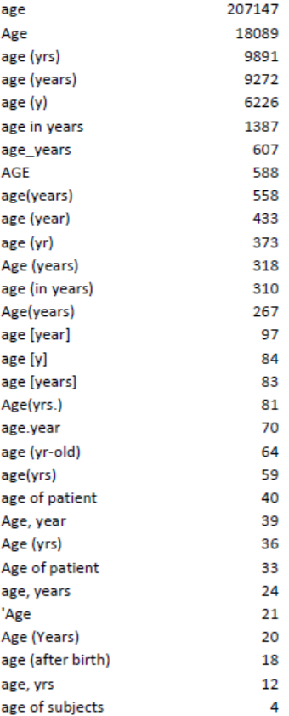

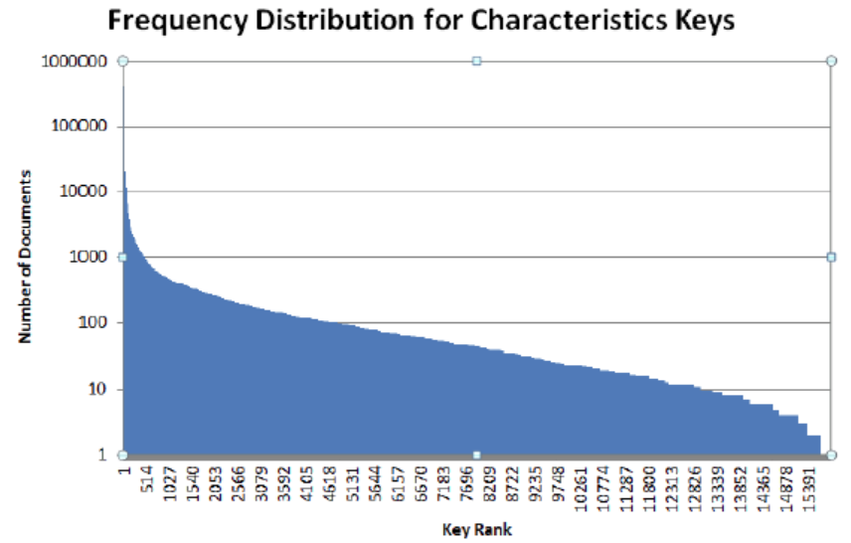
Poor quality (meta)data hampers research

Slide 6
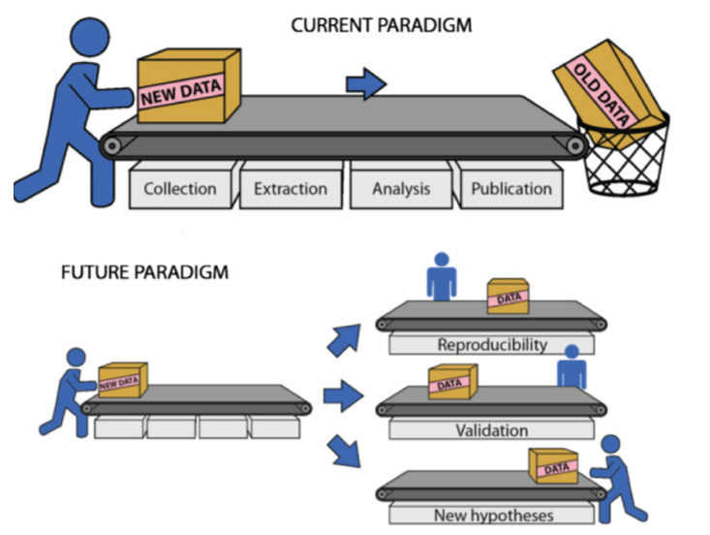
Lambin et al. Radiother Oncol. 2013. 109(1):159-64. doi: 10.1016/j.radonc.2013.07.007

Slide 7
If we are ever to realize the full potential of content we create then we must find ways to reduce the barrier to publish, find and reuse digital content in a responsible manner

Slide 8
Why does this matter?

Slide 9
Most published research findings are false.
- John Ioannidis, Stanford University
PLoS Med 2005;2(8): e124.
Reproducibility of landmark studies is shockingly low:
39% (39/100) in psychology¹
21% (14/67) in pharmacology²
11% (6/53) in cancer³
¹doi:10.1038/nature.2015.17433 ²doi:10.1038/nrd3439-c1 ³doi:10.1038/483531a

Slide 10
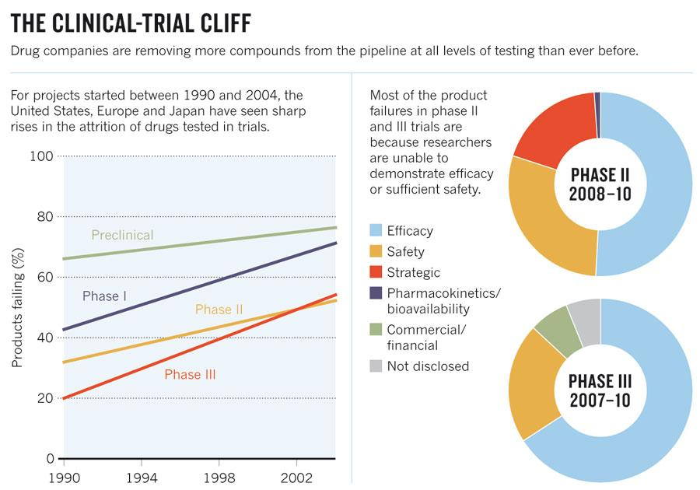
Published online 28 September 2011 | Nature 477, 526-528 (2011) | doi:10.1038/477526a

Slide 11
we need new ways to think about discovery science
We need to improve our confidence in an result
by using more data
and by using multiple lines of evidence

Slide 12
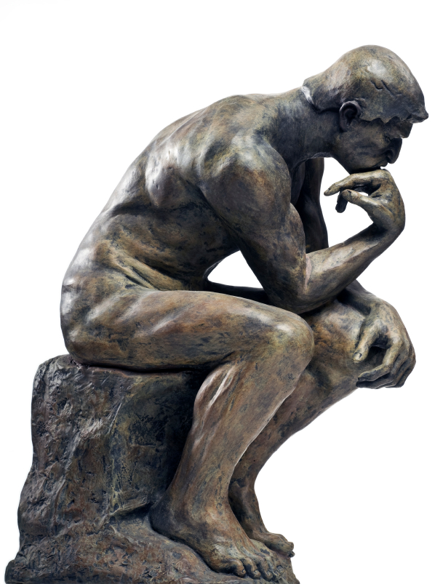
Grand Challenge:
Automatically uncover evidence that supports and disputes a hypothesis using the totality of available data, tools and scientific knowledge

Slide 13
We must build a social, legal and technological infrastructure that facilitates the discovery and reuse of digital resources for people and machines
Notes:
G20: http://europa.eu/rapid/press-release_STATEMENT-16-2967_en.htm
EOSC: https://ec.europa.eu/research/openscience/pdf/realising_the_european_open_science_cloud_2016.pdf
H2020: https://goo.gl/Strjua

Slide 14
Why machines?
Can make sense of vast amounts of information to make personalized, evidence-based decisions to maximize desired outcomes

Slide 15
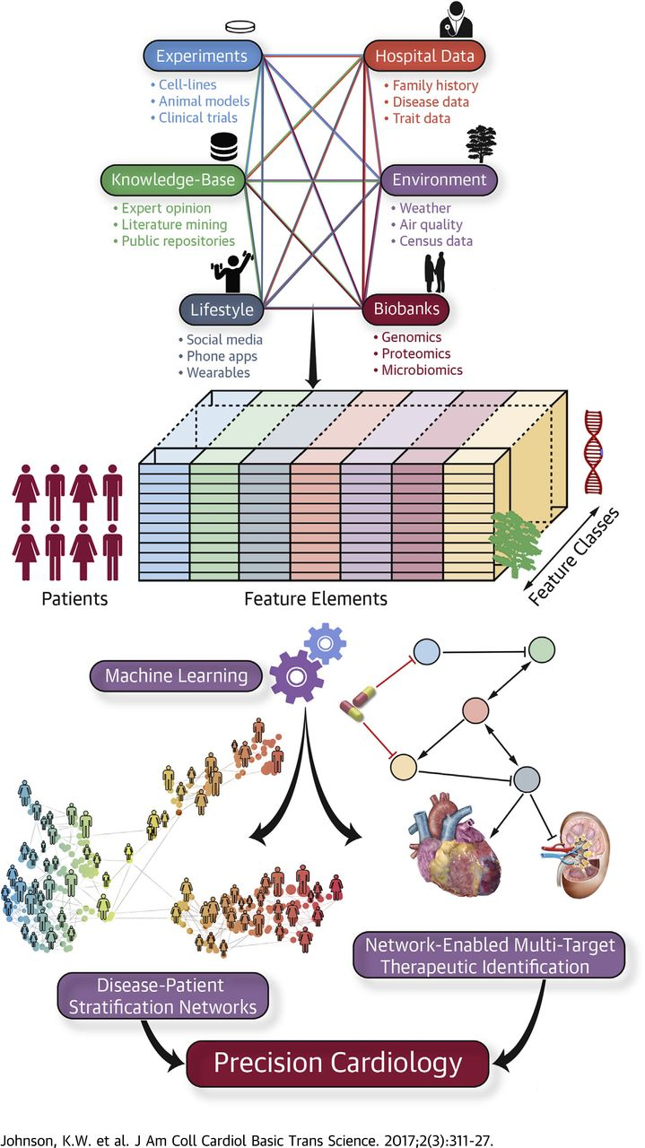
Big Data for Medicine
Multiple sources of heterogeneous data, including experimental evidence, bioinformatics databases, lifestyle measurements, electronic health records, environmental influences, and biobank findings, can be incorporated together using machine learning algorithms to identify causal disease networks, stratify patients, and ultimately predict more efficacious therapies.

Slide 16
Why machines?
Can make sense of vast amounts of information to make personalized, evidence-based decisions to maximize desired outcomes
Can identify and minimize bias in research and in real world applications in a robust and systematic manner

Slide 18
Principles to enhance the value of all digital resources
data, images, software, web services, repositories,…
Developed and endorsed by researchers, publishers, funding agencies, industry partners.

Slide 19
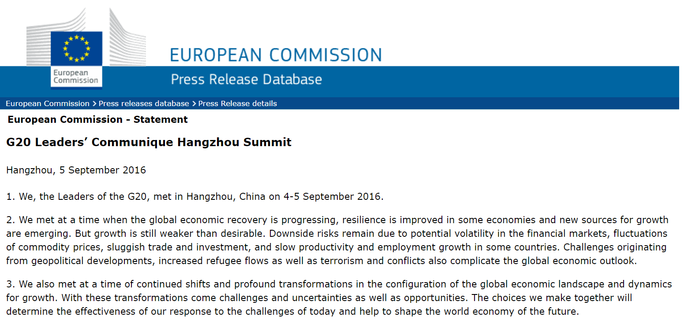
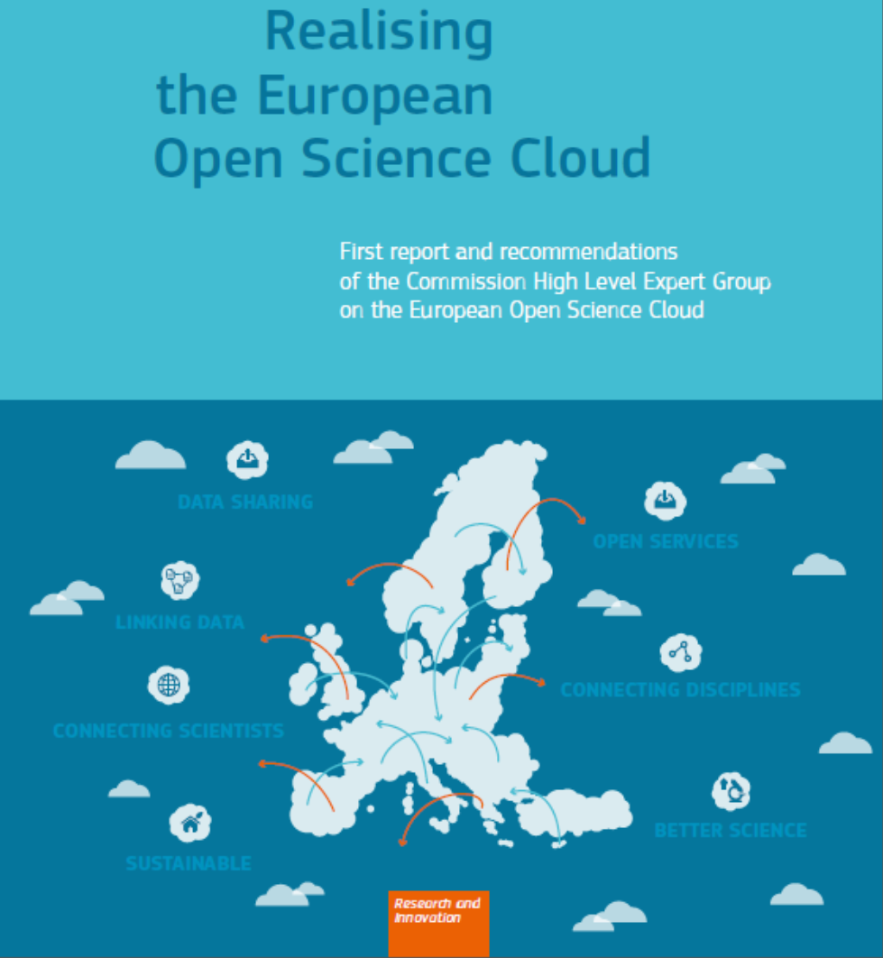
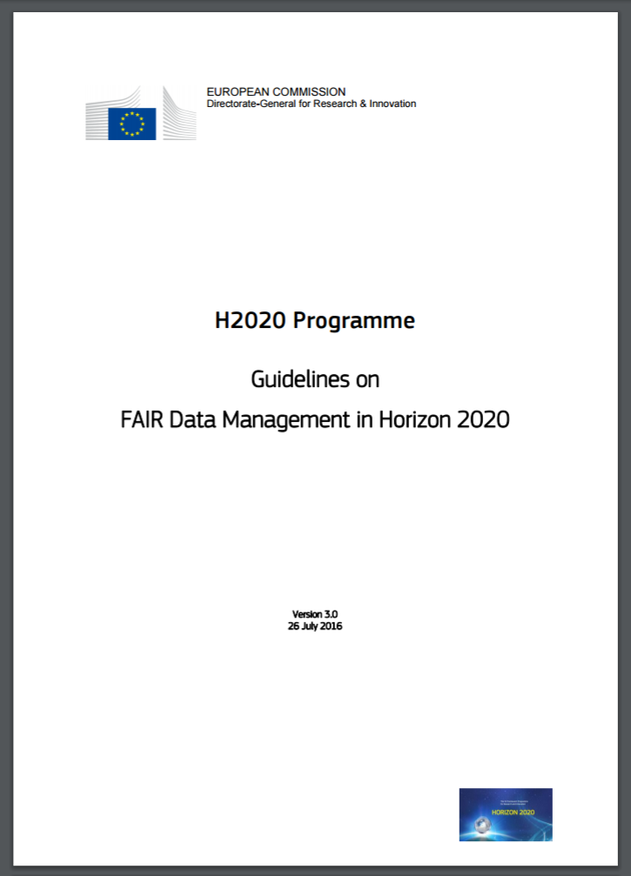


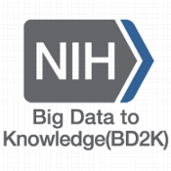
Notes:
G20: http://europa.eu/rapid/press-release_STATEMENT-16-2967_en.htm
EOSC: https://ec.europa.eu/research/openscience/pdf/realising_the_european_open_science_cloud_2016.pdf
H2020: https://goo.gl/Strjua

Slide 20
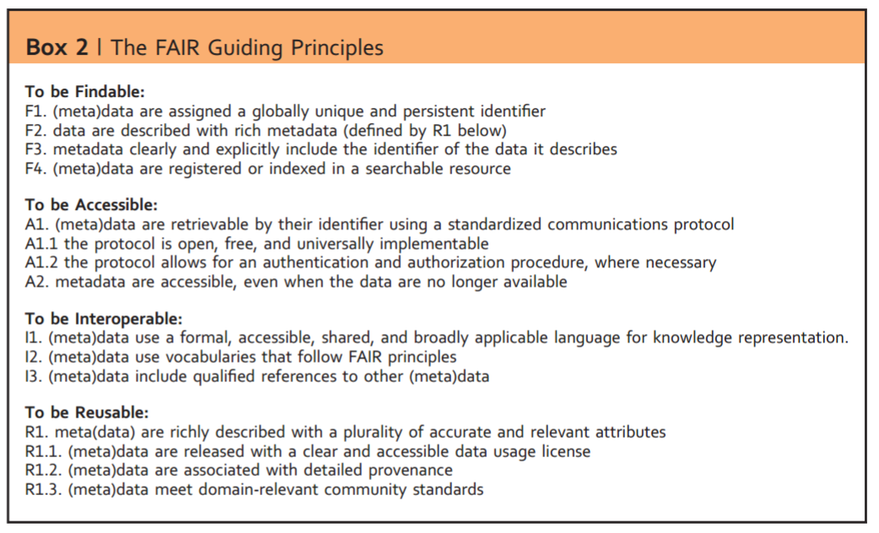
http://www.nature.com/articles/sdata201618
4 Principles (F,A,I,R) and 15 sub-principles.

Slide 21
FAIR Principles - summarized
Findable
Globally unique, resolvable, and persistent identifiers
Machine-readable descriptions to support structured search and filtering
Accessible
Metadata is accessible beyond the lifetime of the digital resource
Clearly defined access and security protocols (FAIR != Open)
Interoperable
Extensible machine interpretable formats for data + metadata
Use FAIR vocabularies and link to other resources
Reusable
Provide licensing, provenance, and use community-standards

Slide 22
Improving the FAIRness of digital resources will increase their quality and their potential and ease for reuse.

Slide 23
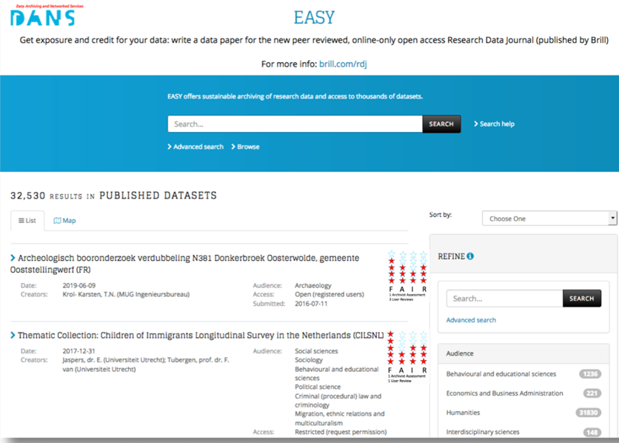
FAIRness assessments may affect which data people use

Slide 24
Communities must make clear their expectations

Slide 25
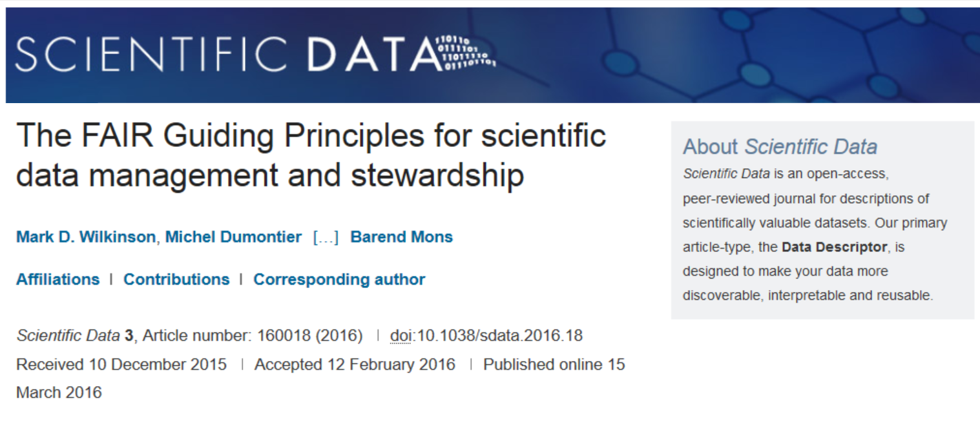
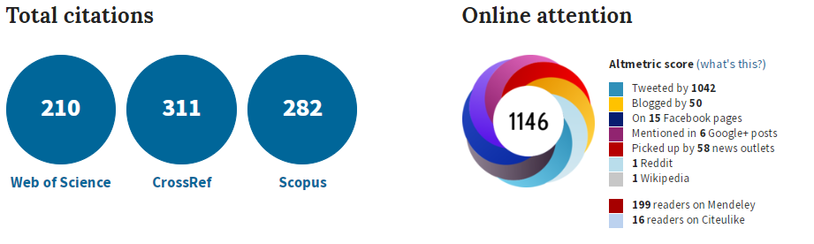
http://www.nature.com/articles/sdata201618
Many of these citations are communities discussing what this means for them
June 2018

Slide 26
Measuring FAIRness
A metric is a standard of measurement.
It must provide clear definition of what is being measured, why one wants to measure it.
It must describe what a valid result is and how one obtains it, so that it can be reproduced by others.

Slide 27
Qualities of a Good Metric
Clear: anyone can understand the purpose of the metric
Realistic: compliance should not be unduly complicated
Discriminating: the measure can distinguish between those resources that meet the criteria and those that do not
Measurable: the assessment can be made in an objective, quantitative, machine-interpretable, scalable and reproducible manner
Universal: The metric should be applicable to all digital resources

Slide 28
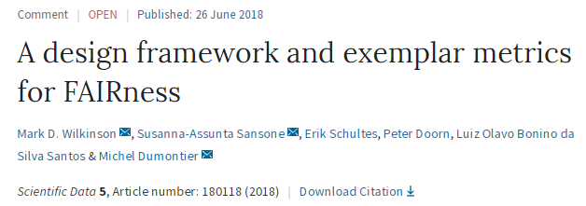
14 universal metrics covering each of the FAIR sub-principles. The metrics demand evidence from the community, some of which may require specific new actions.
Digital resource providers must provide a web-accessible document with machine-readable metadata (FM-F2, FM-F3), detail identifier management (FM-F1B), metadata longevity (FM-A2), and any additional authorization procedures (FM-A1.2).
They must ensure the public registration of their identifier schemes (FM-F1A), (secure) access protocols (FM-A1.1), knowledge representation languages (FM-I1), licenses (FM-R1.1), provenance specifications (FM-R1.2), and community standards (FM-R1.3).
They must provide evidence of ability to find the digital resource in search results (FM-F4), linking to other resources (FM-I3), FAIRness of linked resources (FM-I2), and meeting community standards (FM-R1.3)

Slide 29
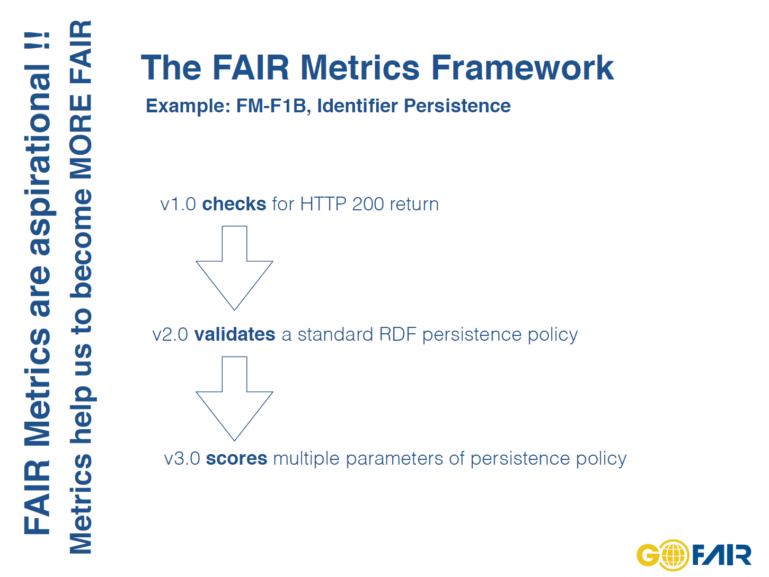

Slide 30
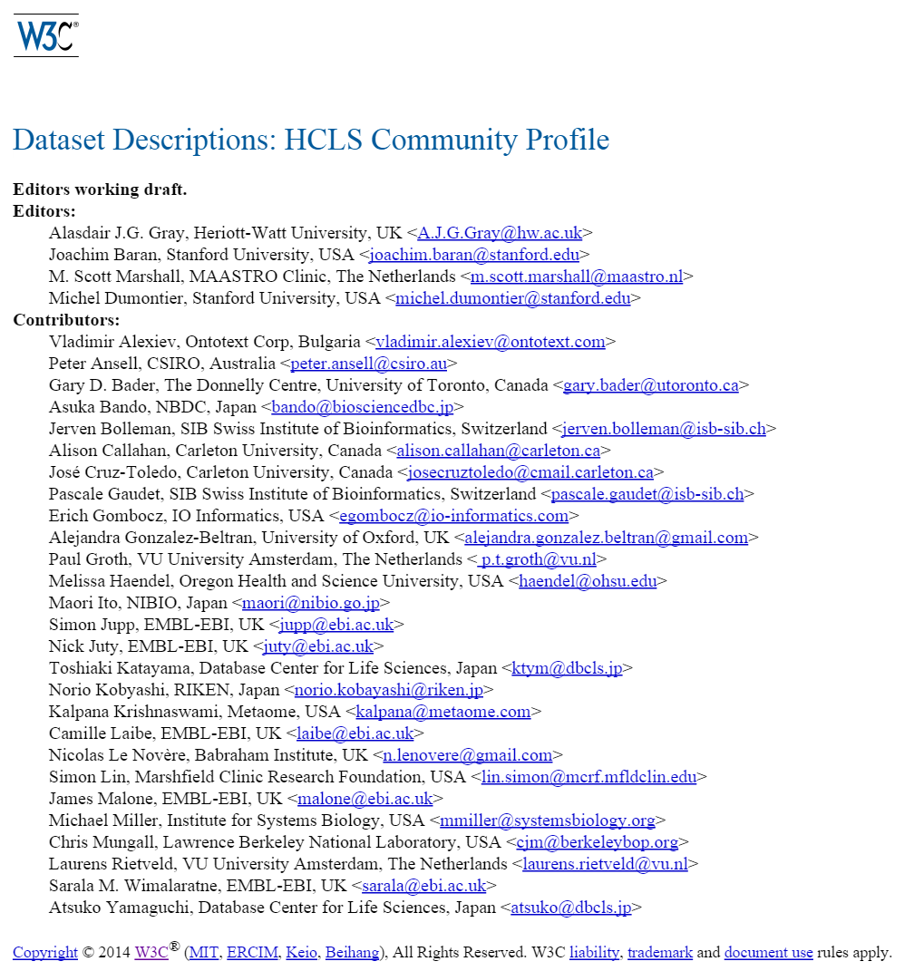
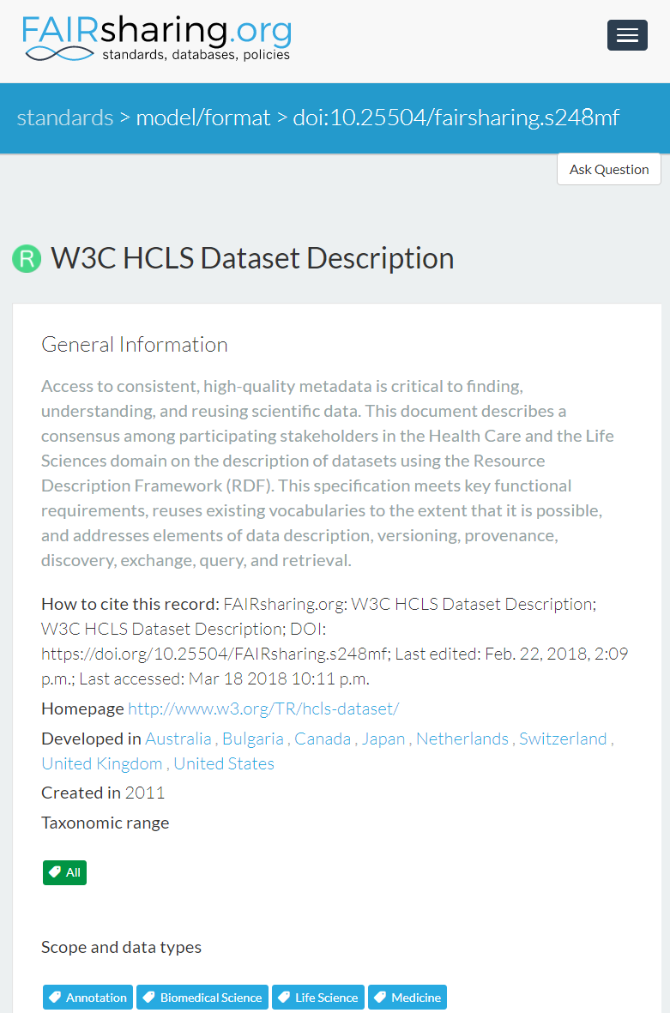
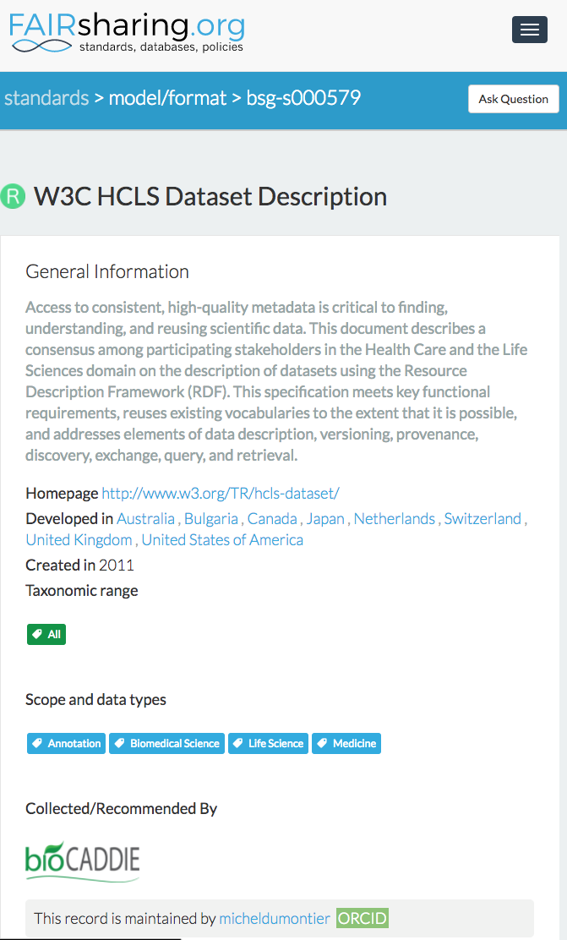
Evidence: standard is registered in FAIRsharing
http://www.w3.org/TR/hcls-dataset/

Slide 31
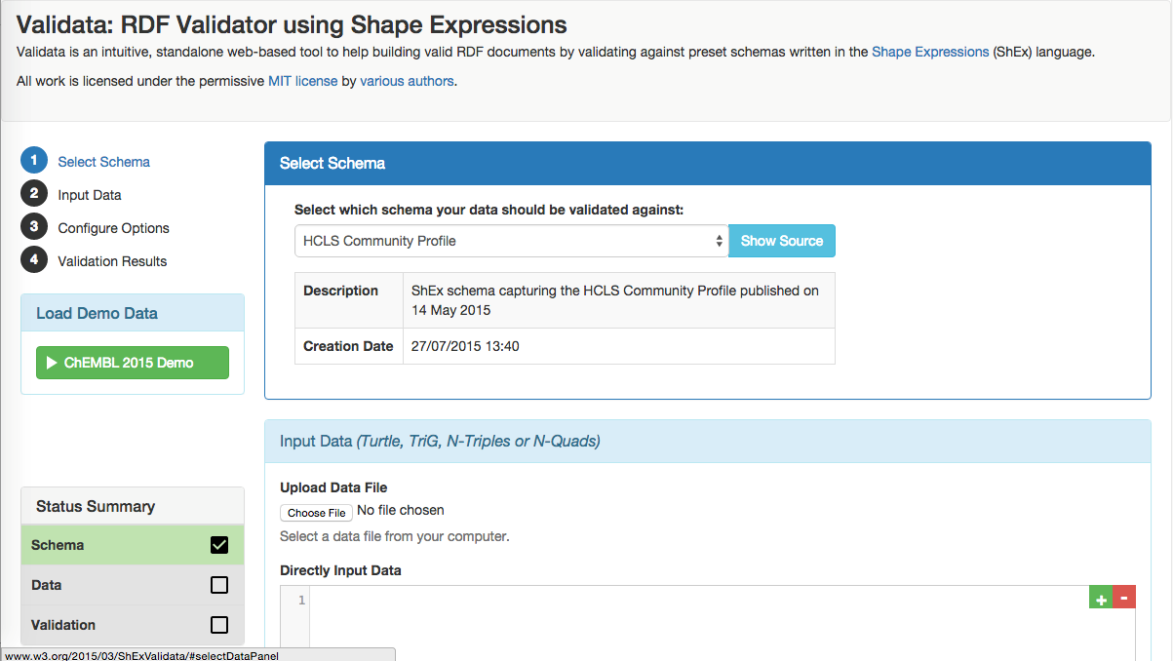
Compliance to the standard can be automatically assessed
RDF constraint validation tool that is configurable to any profile
Declarative reusable schema description
Shape Expression (ShEx) constraints
http://hw-swel.github.io/Validata/

Slide 32
A first assessment using the metrics
Used a simple form to ask for the information needed as input to the FAIR metrics
Questions either require one or more URL or true/false

Slide 33
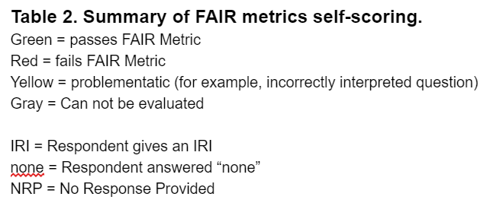
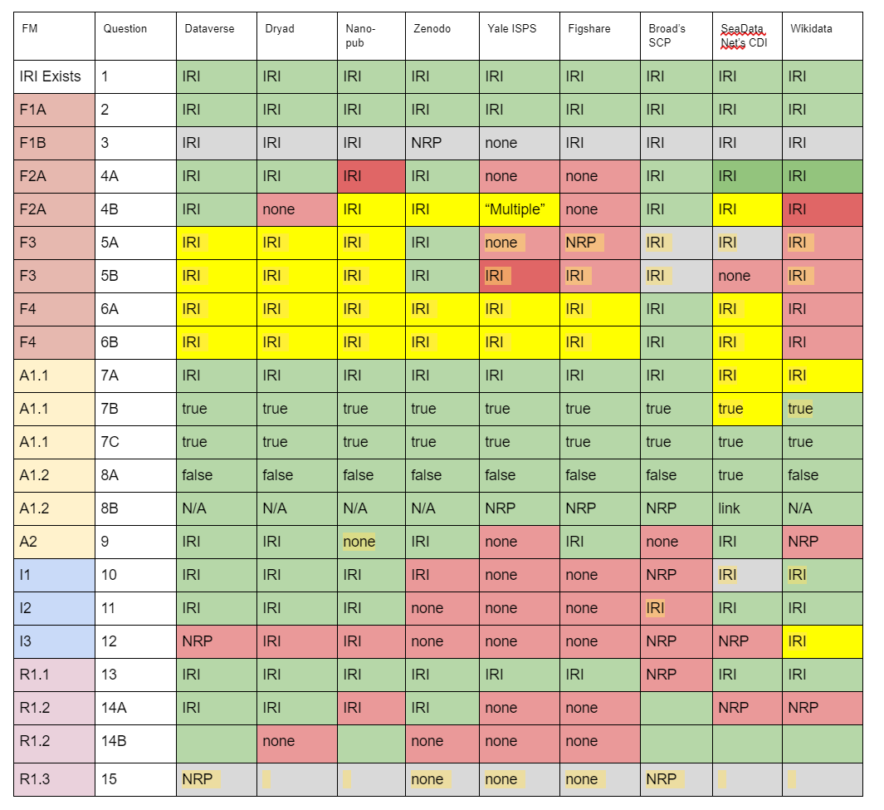

Slide 34
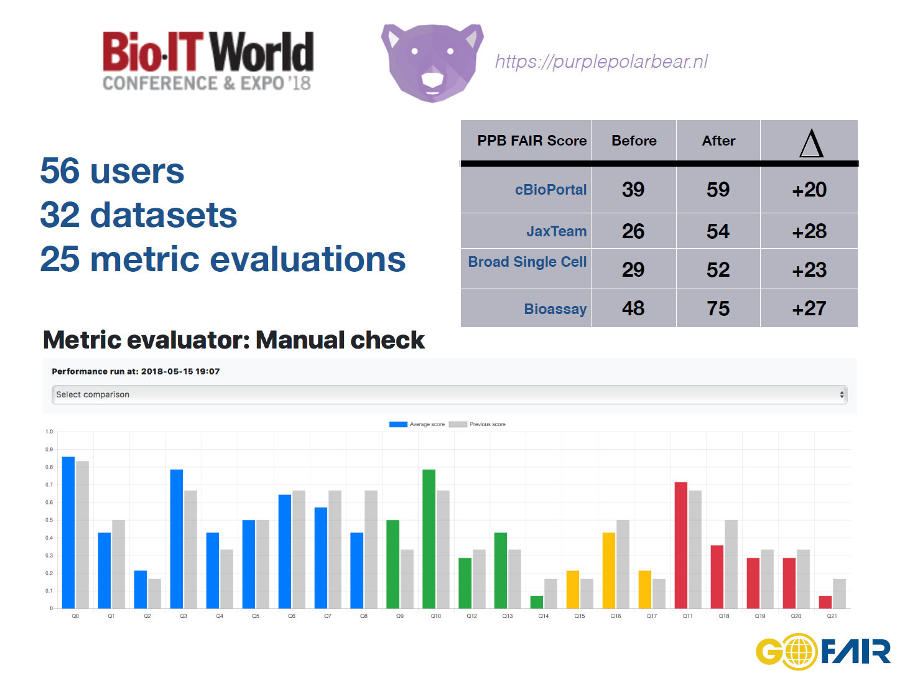

Slide 35
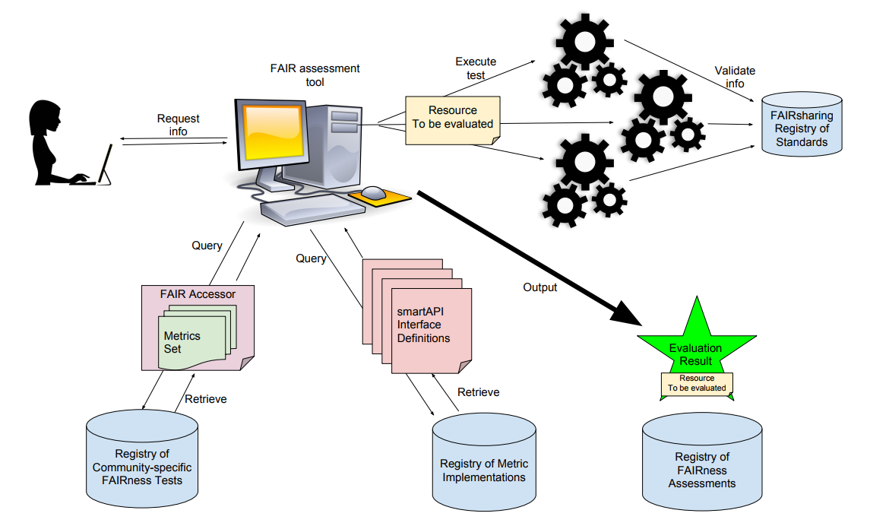
Automated FAIRness assessments

Slide 36
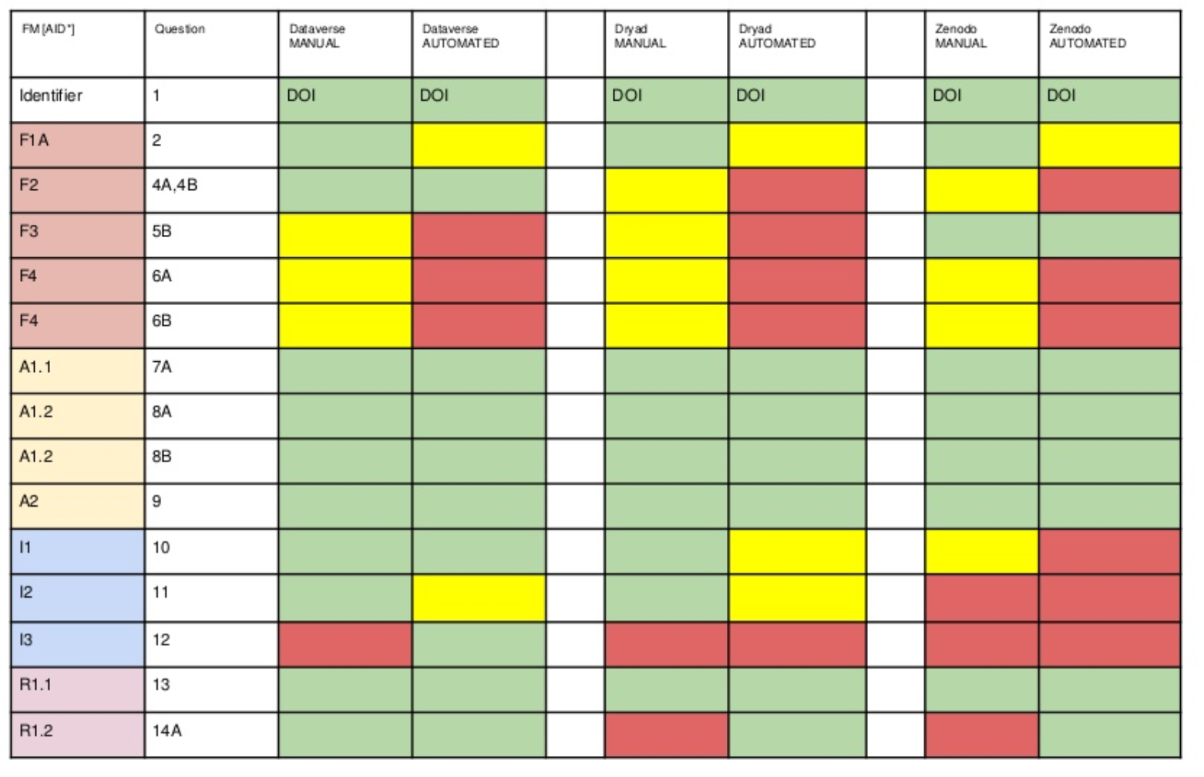
Automated assessments are rather unforgiving, but also correct mistakes

Slide 37
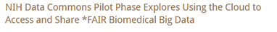
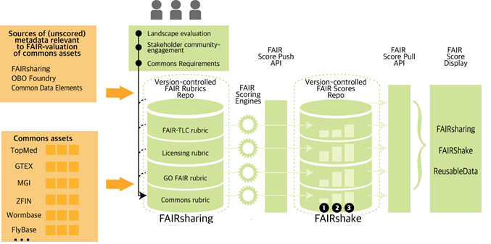

Slide 38
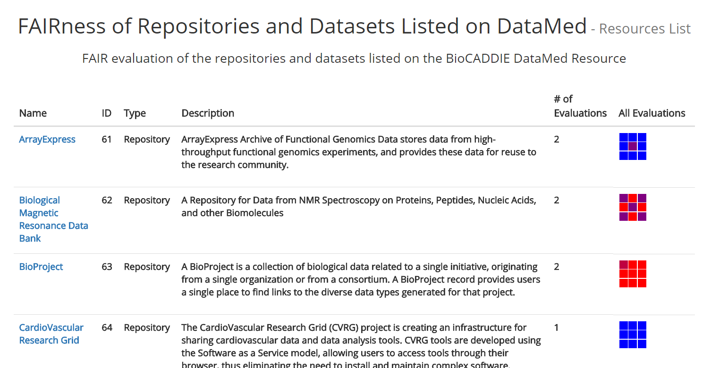
FAIRShake

Slide 39
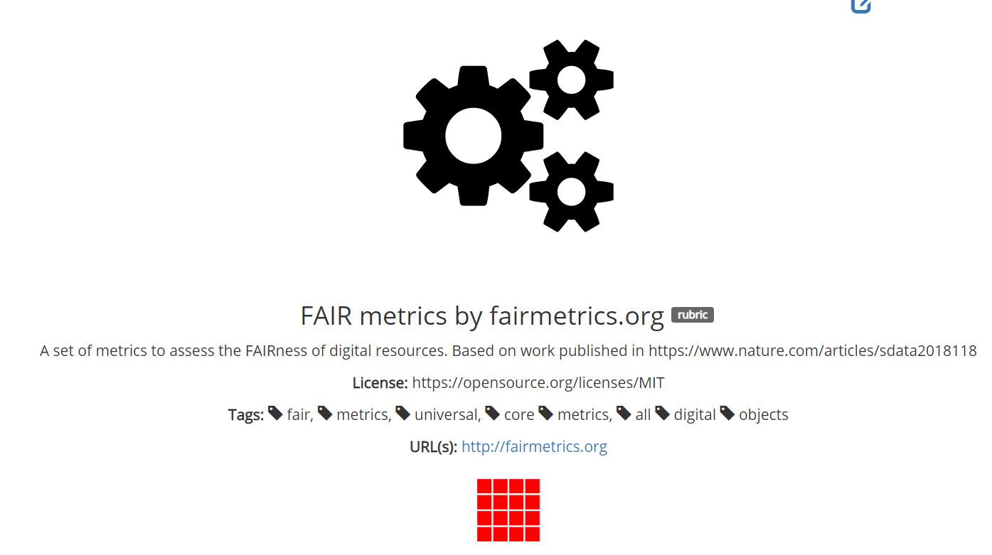
http://fairshake.cloud

Slide 40
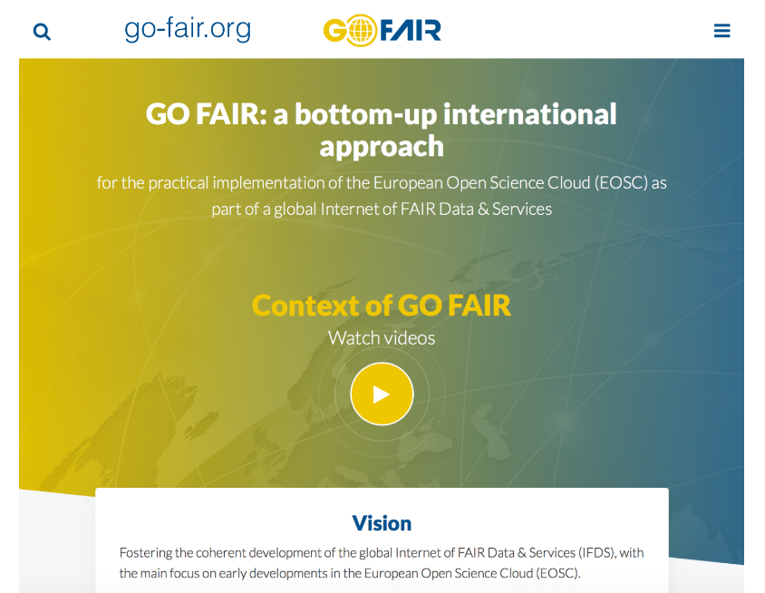

Slide 41
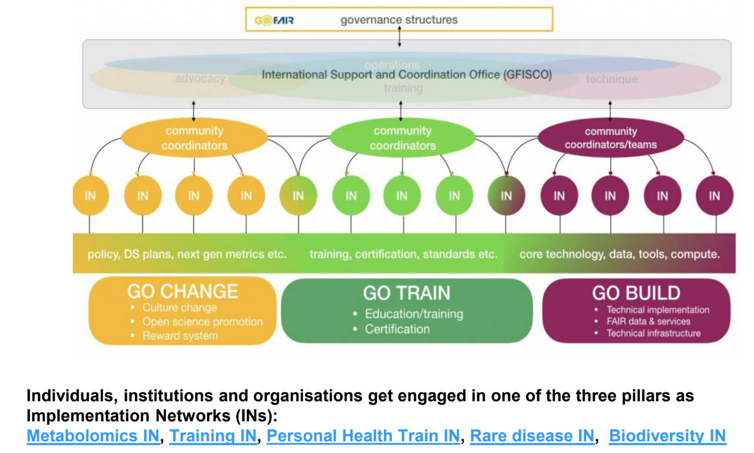
Celia van Gelder (DTL/ELIXIR-NL)

Slide 42

H2020 EG: Turning FAIR Data into Reality - Report and Action Plan Consultation
Recommendations include:
Sustainable Funding for FAIR components (#5)
Strategic and evidence-based funding (#6)
Cross-Disciplinary FAIRness (#8)
Encourage and incentivize data reuse (#19)
Facilitate automated processing (#25)
Data science and stewardship skills (#26)
Skills transfer schemes and brokering roles (#27)
Curriculum frameworks and training (#28)
Consultation until 5 August
Consultation is being conducted on the interim report and Action Plan until 5 August 2018. A commentable version of the report is available on Google Drive. Structured comments on the Action Plan and specific recommendations and actions may be made via a dedicated GitHub repository.
· Comment on Report: http://bit.ly/interim_FAIR_report
· Comment on Action Plan: https://github.com/FAIR-Data-EG/action-plan

Slide 43
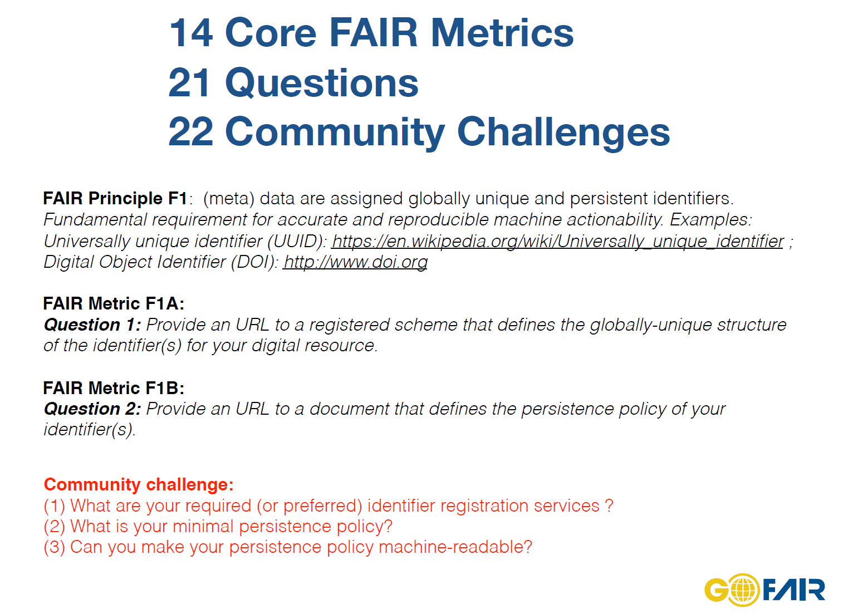

Slide 44
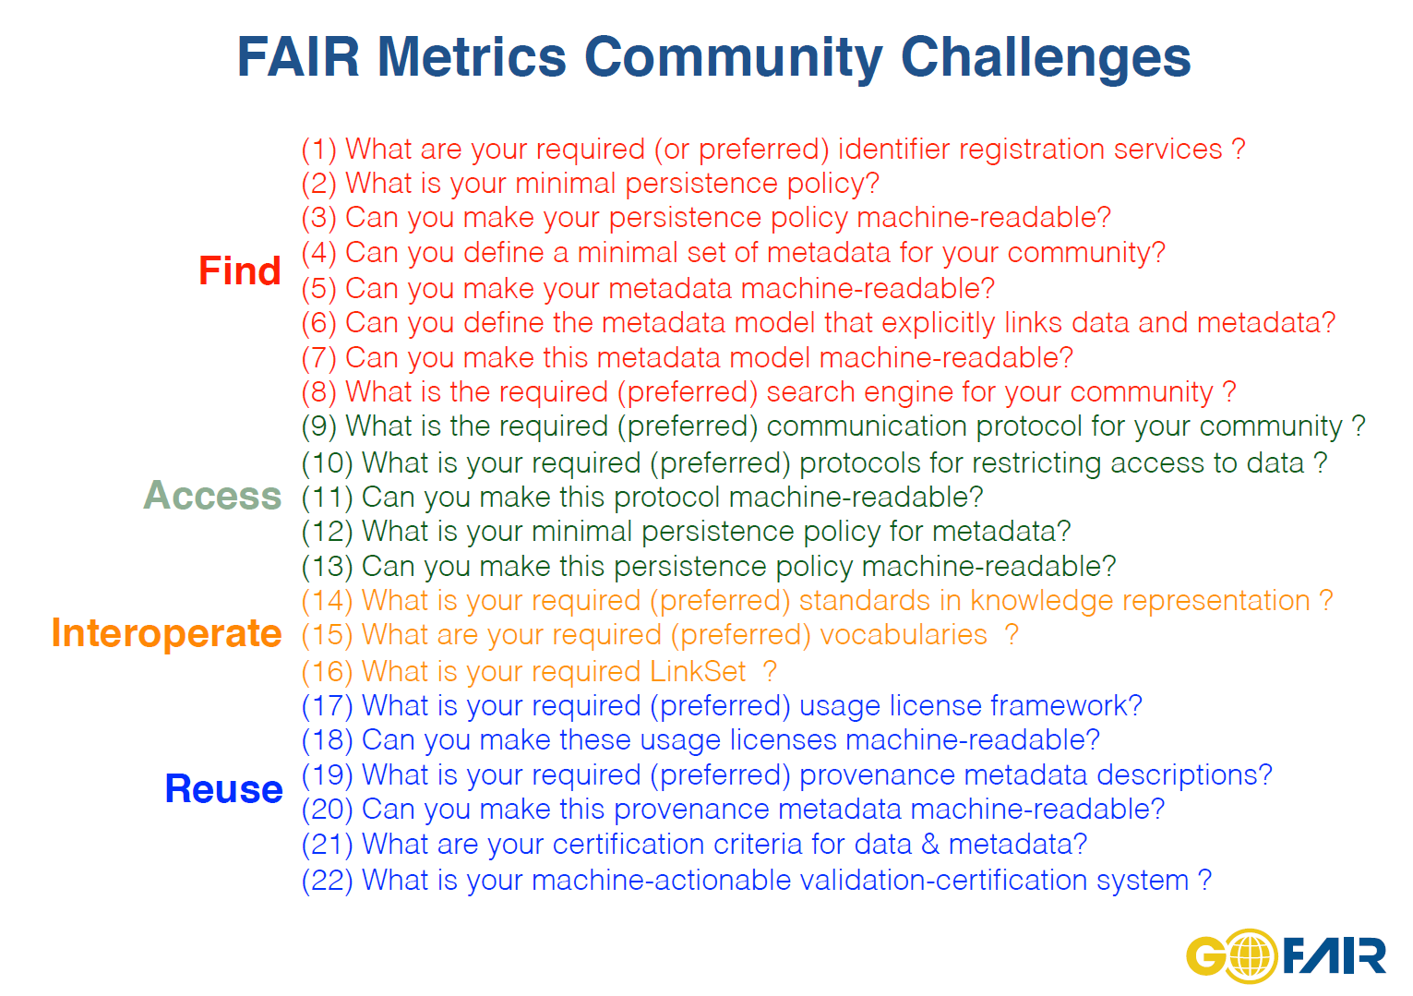

Slide 45
Summary
FAIR represents a global initiative to enhance the discovery and reuse of all kinds of digital resources
The FAIR concept is maturing quickly. Make sure to participate!
Huge benefits to be had, particularly in augmenting existing research programs and in automated machine processing, but needs to be coupled with the proper training and ethics.
It demands a new social, legal and technological infrastructure that currently doesn’t exist in whole, but has to be built for and tested by various communities!

Slide 46
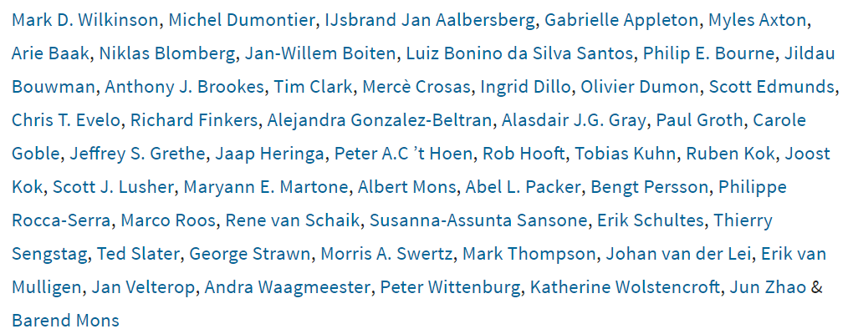






Acknowledgements
Dumontier Lab (Maastricht University, Stanford University, Carleton University)
MU: Seun Adekunle, Dorina Claessens, Pedro Hernandez Serrano, Andine Havelange, Lianne Ippel, Alexander
Malic, Kody Moodley, Stuti Nayak, Nadine Rouleaux, Claudia van open, Chang Sun, Amrapali Zaveri
SU: Sandeep Ayyar, Shima Dastgheib, Remzi Celebi, Maulik Kamdar, David Odgers, Maryam Panahiazar
CU: Alison Callahan, Jose Toledo-Cruz, Natalia Villaneuva-Rosales
FAIR
FAIR metrics

Slide 47
The mission of the Institute of Data Science at Maastricht University is to foster a collaborative environment for multi-disciplinary data science research, interdisciplinary training, and data-driven innovation .
We tackle key scientific, technical, social, legal, ethical issues that advance our understanding and strengthen our communities in the face of these developments.
michel.dumontier@maastrichtuniversity.nl
Website: http://maastrichtuniversity.nl/ids

